Slide 1


Cover
Transition
Contents
MovieIQ: Film Success Intelligence
Name: Ayush Dash
Date:19th Aug, 2026

Slide 2

Contents
1. Product Vision and Business Context
2. Data Foundation and Analytical Workflow
01
02
3. Interactive Business Intelligence
4. Financial, Genre, and Audience Intelligence
03
04
5. Statistical Evidence and Predictive Modeling
6. Business Value, Risks, and Conclusion
05
06

Slide 3
Cover
Transition
Contents
part
01
1. Product Vision and Business Context

Slide 4

MovieIQ at a Glance
Purpose
MovieIQ is an interactive Streamlit platform that transforms historical movie data into financial, audience, statistical, and predictive intelligence for early-stage decision support.
Analytical Capabilities
The platform combines exploratory data analysis, financial analytics, genre intelligence, audience analysis, hypothesis testing, machine learning, and interactive business intelligence.
Project Profile
Presented by Ayush Dash as a 2026 data analytics and business intelligence portfolio project, built with Python, Pandas, NumPy, Plotly, SciPy, Scikit-learn, and Streamlit.

Slide 5
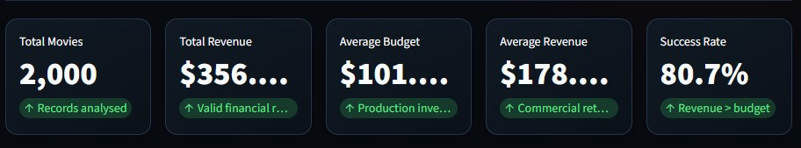
Executive Overview screenshot

Slide 6
The Business Problem
01
02
03
Industry Uncertainty
Core Questions
Analytical Response
Film projects involve substantial financial uncertainty because investment decisions are made before revenue, audience response, and market performance are known.
Decision-makers need to understand whether budget, genre, popularity, ratings, and other historical characteristics are associated with stronger financial outcomes.
MovieIQ addresses these questions through a structured workflow that combines descriptive analysis, statistical evidence, and predictive classification.

Slide 7
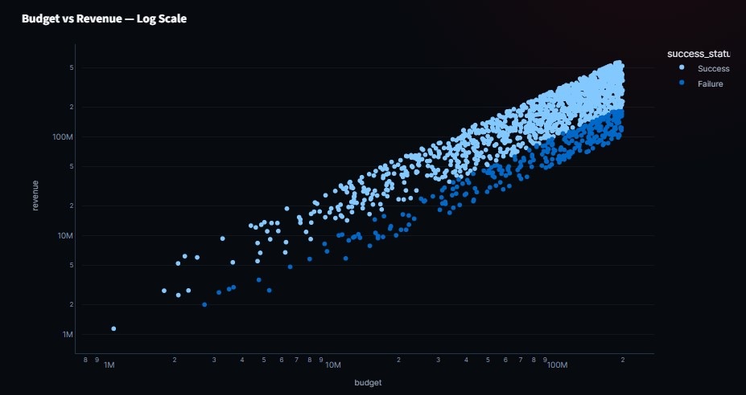
Budget vs Revenue scatter plot

Slide 8
Project Objectives
Analyse historical budgets, revenues, profits, ROI, and success rates to identify recurring patterns in movie performance.
Financial Understanding
Examine how genres, popularity, ratings, vote counts, and runtime relate to financial outcomes and audience engagement.
Audience and Genre Intelligence
Build and evaluate a Random Forest classifier that uses historical movie characteristics to distinguish success from failure.
Predictive Decision Support
Translate analytical outputs into a Streamlit dashboard that enables users to explore portfolio-level and movie-level insights.
Interactive Delivery

Slide 9



Defining Movie Success
A movie is classified as successful when Revenue > Budget. Success receives a value of 1, while Revenue ≤ Budget receives a value of 0.
This definition supports analytical classification but does not represent complete accounting profit because marketing, distribution, taxes, financing, and revenue-sharing costs are excluded.
The success label should be interpreted as a historical financial signal rather than a guaranteed measure of commercial or accounting profitability.
Analytical Classification
Interpretation Boundary
Decision-Support Role

Slide 10
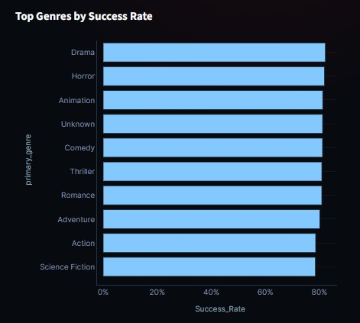
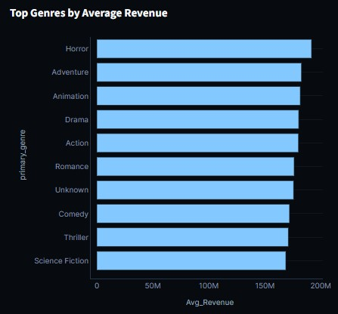
Success vs Failure / Average Revenue by Outcome

Slide 11
Cover
Transition
Contents
part
02
2. Data Foundation and Analytical Workflow

Slide 12
Dataset Structure
Core Movie Fields
Dynamic Preparation
Analytical Readiness
The dataset includes title, budget, revenue, popularity, runtime, vote average, vote count, genres, and release date.
MovieIQ prepares the dataset dynamically before analysis, enabling the application to validate, transform, and enrich historical records during execution.
The preparation process creates a consistent foundation for financial comparison, audience analysis, statistical testing, visualization, and machine learning.

Slide 13
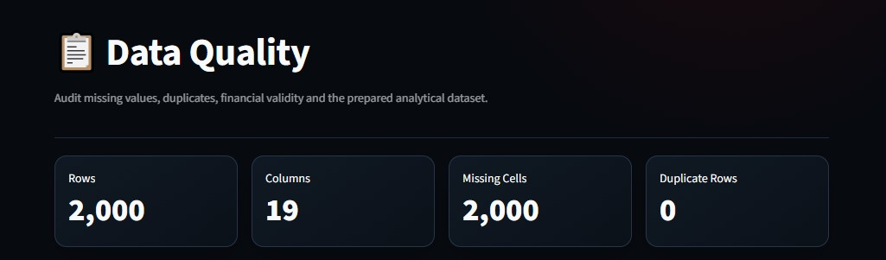
Data Quality Structure

Slide 14



Data Preparation and Feature Engineering
Data Quality
Derived Features
Analytical Segments
Numeric fields are converted into analytical formats, missing values are handled, and financial records are validated before downstream analysis.
The platform creates success, profit, ROI, primary genre, and release year variables to support consistent comparisons across movies.
Additional segments are created for budget, rating, popularity, and revenue, allowing users to compare performance across meaningful categories.

Slide 15
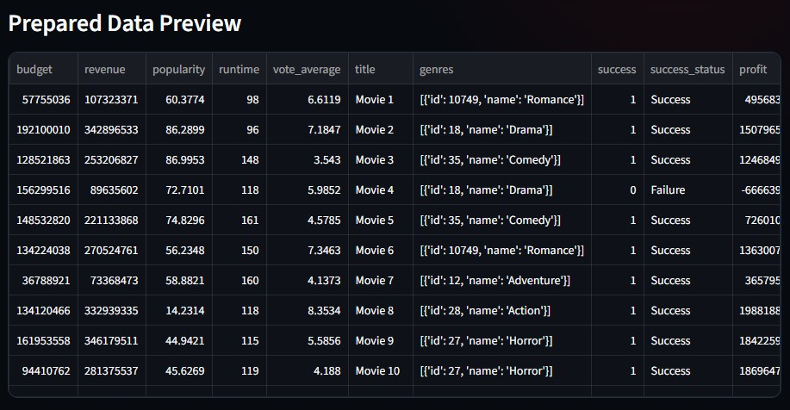
Data Quality → Prepared Data Preview

Slide 16
End-to-End Analytical Workflow
Data-to-Insight Pipeline
Business Translation
Raw movie data flows through loading, cleaning, feature engineering, exploratory analysis, financial analysis, genre analysis, audience analysis, correlation analysis, statistical testing, classification, and evaluation.
The workflow concludes by converting quantitative findings into business insights that can inform project screening, portfolio review, and audience-oriented decisions.

Slide 17



Financial Measurement Framework
Profit
ROI
Success
Profit is calculated as Revenue − Budget, providing a direct measure of the difference between reported revenue and production budget.
ROI is calculated as (Revenue − Budget) / Budget, enabling relative comparison between movies with different investment levels.
Success equals 1 when Revenue exceeds Budget and 0 otherwise, creating the target variable for classification and group comparisons.

Slide 18
Cover
Transition
Contents
part
03
3. Interactive Business Intelligence

Slide 19



Executive Portfolio Overview
Portfolio KPIs
Core Visuals
Decision-Maker Value
The Executive Overview presents total movies, total revenue, average budget, average revenue, and overall success rate for rapid portfolio assessment.
Budget-versus-revenue relationships, genre performance, and executive signals provide a concise view of financial patterns across the movie portfolio.
The page helps producers, studios, and investors understand overall portfolio performance before investigating individual titles or analytical drivers.

Slide 20

Movie-Level Explorer
Interactive Filtering
01
Users can search movies and filter records by genre, success status, rating, popularity, and release year.
Flexible Sorting
02
Movies can be ranked by revenue, profit, ROI, rating, popularity, or budget to support different investigation priorities.
Individual Profiles
03
Each movie profile provides detailed performance metrics, enabling users to move from portfolio-level patterns to title-level evaluation.

Slide 21
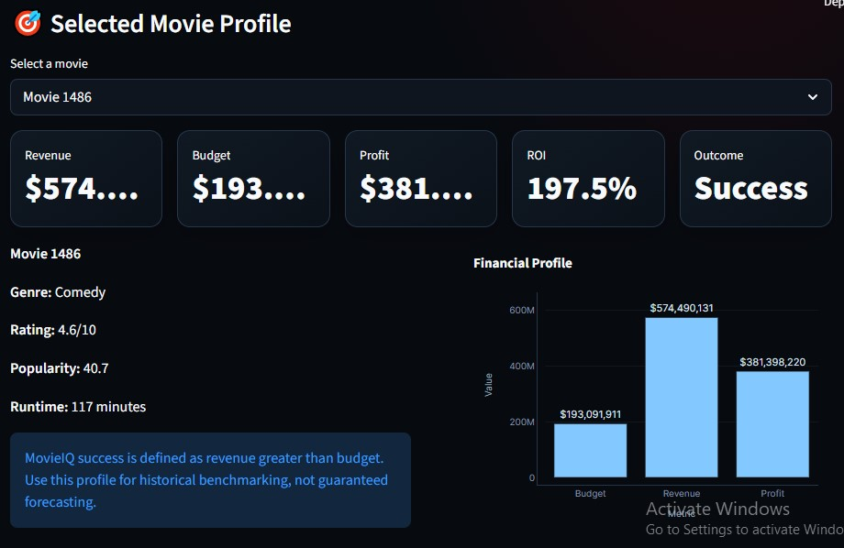
Movie Explorer Screenshots

Slide 22
Technology Architecture
Analytical Stack
Visual and Statistical Stack
Machine Learning and Delivery
Python powers the workflow, while Pandas and NumPy support data manipulation and numerical analysis.
Plotly provides interactive visualizations, and SciPy supports statistical testing and evidence-based interpretation.
Scikit-learn provides the Random Forest model, while Streamlit delivers the interactive dashboard. Development can be supported through VS Code, Jupyter, and Google Colab.

Slide 23
Cover
Transition
Contents
part
04
4. Financial, Genre, and Audience Intelligence

Slide 24

Financial Performance Analysis
Key Measures
01
The analysis compares total revenue, total budget, total profit, and average ROI across the movie portfolio.
Performance Comparisons
02
Visual outputs examine budget versus revenue, ROI distributions, and revenue differences between successful and unsuccessful movies.
Business Objective
03
The goal is to identify the financial characteristics that distinguish stronger outcomes from weaker historical performance.

Slide 25
Budget and Revenue Relationship
Analytical Question
The analysis investigates whether movies with larger budgets tend to generate higher revenue.
01
Evidence Used
03
02
Interpretation
Budget is compared with revenue through visual analysis and Pearson correlation, while successful and unsuccessful outcomes are evaluated separately.
A relationship indicates association between budget and revenue; it does not prove that increasing budget alone causes higher revenue.

Slide 26
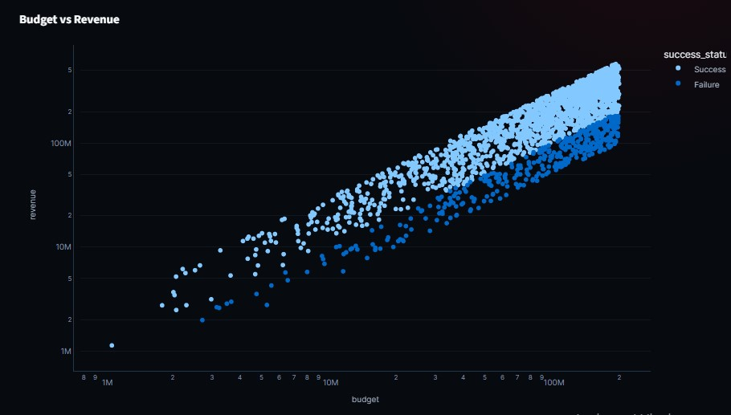
Budget vs Revenue + ROI Distribution

Slide 27

Genre Intelligence
Performance Dimensions
Strategic Questions
Scope of Insight
Genres are evaluated using movie count, average revenue, average budget, average ROI, and success rate.
The analysis identifies genres associated with higher revenue, stronger success rates, or more efficient returns on investment.
Genre patterns describe historical performance and should support, rather than replace, creative judgment and market-specific research.

Slide 28
Audience Intelligence
01
02
03
Audience Signals
Comparative Views
Analytical Caution
MovieIQ analyses popularity, vote average, vote count, revenue, and success to examine audience engagement and financial performance.
Popularity-versus-revenue and rating-versus-revenue analyses compare audience signals across successful and unsuccessful movies.
Audience indicators may be associated with financial outcomes, but the observed relationships do not establish direct causation.

Slide 29



Success Driver Analysis
Candidate Drivers
Comparative Methods
Decision Perspective
The platform evaluates budget, revenue, profit, ROI, popularity, runtime, vote average, vote count, and success.
A correlation matrix examines numerical relationships, while group comparisons identify differences between successful and unsuccessful movies.
The analysis highlights potential success drivers that can guide further investigation, feature refinement, and predictive modeling.

Slide 30
Cover
Transition
Contents
part
05
5. Statistical Evidence and Predictive Modeling

Slide 31



Statistical Analysis Framework
Purpose
Tests Applied
Significance Standard
Statistical testing moves the analysis beyond visual patterns by assessing whether observed differences and relationships have measurable evidence.
MovieIQ uses an independent t-test, chi-square test, and Pearson correlation to examine group differences, categorical association, and linear relationships.
All hypothesis tests use a significance level of α = 0.05, providing a consistent threshold for interpreting statistical evidence.

Slide 32



Independent T-Test
Research Question
Hypotheses
Interpretation
The test compares average popularity between successful and unsuccessful movies to determine whether the two groups show statistically different means.
H₀: Mean popularity is equal between successful and unsuccessful movies. H₁: Mean popularity differs between the two groups.
The conclusion is based on the resulting p-value. A statistically significant result suggests evidence of a group difference, not necessarily a causal effect.

Slide 33

T-Test KPI/result screenshot

Slide 34
Chi-Square and Pearson Correlation
Chi-Square Test
Pearson Correlation
Evidence Boundary
The chi-square test examines whether genre and movie success are associated. H₀ states that genre and success are independent at α = 0.05.
Pearson correlation measures the linear relationship between budget and revenue and reports both a correlation coefficient and a p-value.
Both tests identify statistical association. Neither test alone proves that genre or budget causes a movie to succeed.
01
02
03

Slide 35

Chi-square + Pearson results screenshot

Slide 36



Predictive Classification
Modeling Task
Model Features
Dynamic Training
The Random Forest classifier predicts whether a movie belongs to the success or failure class defined by the Revenue > Budget rule.
The model uses budget, popularity, runtime, vote average, and primary genre as historical movie characteristics.
The model is trained inside the Streamlit application, so no separate `random_forest.pkl` file is required.

Slide 37
Random Forest Configuration
Model Design
Robustness Settings
Computational Setup
The classifier uses 300 estimators, maximum depth of 10, minimum samples split of 5, and minimum samples leaf of 2.
Balanced class weights help address uneven class distributions, while random state 42 supports reproducible results.
Parallel processing improves training efficiency while preserving the model’s ability to capture nonlinear relationships among movie characteristics.

Slide 38
Model Evaluation
Performance Metrics
MovieIQ reports accuracy, precision, recall, F1 score, and ROC-AUC to provide a balanced view of classification quality.
01
Diagnostic Outputs
The dashboard includes a confusion matrix, ROC curve, classification report, and feature importance analysis.
02
03
Why Multiple Metrics Matter
Accuracy alone can be misleading when class distributions are uneven; multiple metrics reveal both overall performance and class-specific behavior.

Slide 39
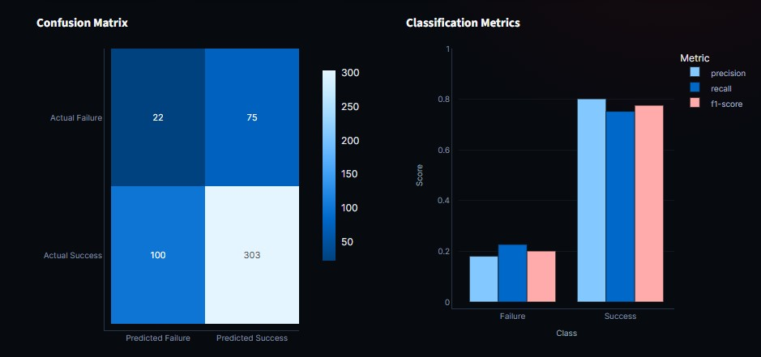
Confusion Matrix + ROC Curve + Feature Importance

Slide 40
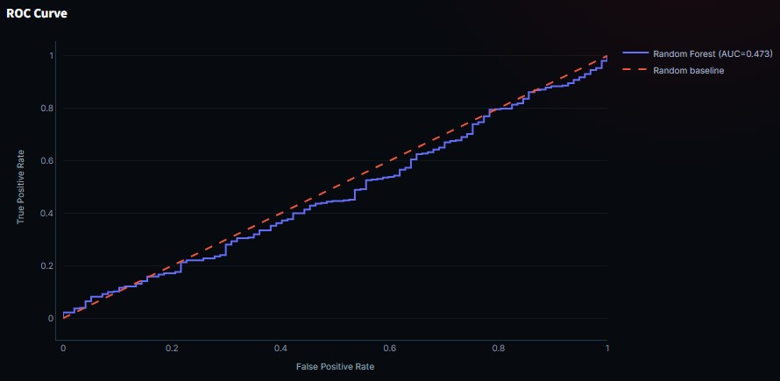
Confusion Matrix + ROC Curve + Feature Importance

Slide 41
Cover
Transition
Contents
part
06
6. Business Value, Risks, and Conclusion

Slide 42
Business Value by Stakeholder
Producers and Studios
Producers can benchmark proposed projects against historical patterns, while studios can use the platform for early-stage project screening.
Investors
Investors can treat financial metrics and model outputs as supporting evidence when evaluating risk and potential return.
Marketing Teams
Marketing teams can analyse historical audience engagement signals to understand how popularity and ratings relate to financial outcomes.

Slide 43
Analytical Limitations
Missing Business Variables
The dataset excludes marketing expenditure, cast popularity, director influence, distributor, production company, competition, advertising strategy, and market conditions.
Interpretation Risk
Historical correlations may reflect hidden factors or selection effects, and the success label does not capture complete accounting profitability.
Responsible Use
Predictions should be treated as decision-support signals rather than guaranteed outcomes, especially when evaluating new projects outside the historical data range.

Slide 44
From Data to Decision Support
Integrated Intelligence
Practical Outcome
Strategic Takeaway
MovieIQ connects data preparation, exploratory analysis, financial metrics, statistical testing, machine learning, visualization, and business interpretation in one workflow.
The platform helps users understand financial performance, audience behaviour, genre patterns, and historical success drivers through interactive analysis.
MovieIQ does not eliminate uncertainty; it makes uncertainty more measurable, structured, and actionable for early-stage movie decisions.

Slide 45
Closing Message
01
02
03
Final Insight
Platform Contribution
Thank You
Historical movie data can reveal meaningful patterns in budgets, revenues, genres, audience signals, and success outcomes when analysed through a disciplined framework.
MovieIQ demonstrates how analytics and machine learning can transform raw entertainment data into an accessible business intelligence product.
Thank you. Presented by Ayush Dash, Data Analyst and Business Intelligence Analyst Portfolio Project.

Slide 46
Cover
Transition
Contents
Thank you

